Slide 2
Our Show’s Mission
To promote the virtues of locally grown and prepared foods
To promote the virtues of our Dubuque Food Co-op
To promote the virtues of fresh organically grown wholesome foods
To provide opportunities for producers to connect with their customers

Slide 3
Building Brand Equity
Series-style video applied to broadcast, cable and Web television is one of the most powerful and effective means of brand marketing
Series television affords more exposure, lower cost-per-thousand
It creates its own audience of enthusiastic fans, and when coupled with social media it builds upon that audience in ways no other marketing form works

Slide 4
Critical to long-term success
Because this is a television project, the show has excellent potential to earn revenue or at the very least earn enough to sustain itself.

Slide 5
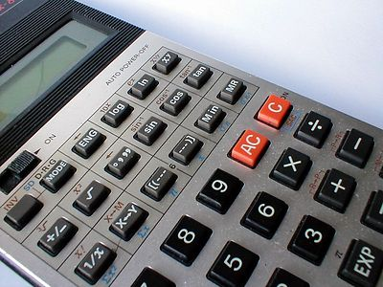
Critical to long-term success
Therefore the show should be organized around a solid business plan with the goal of producing revenue streams from sponsorship contracts.
Beneficiaries include
Dubuque Food Co-op
Matter
The Co-op Cookery Production

Slide 6
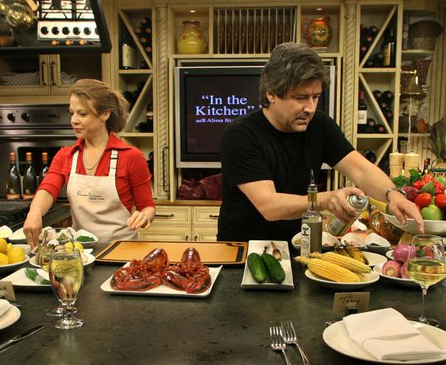
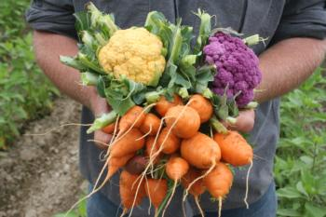
What does a show consist of?
It’s ostensibly a cooking show
Shopping with the chef
Cooking on camera
But it’s also a gardening show
We visit area farms and gardens to learn where food comes from and who grows it

Slide 7
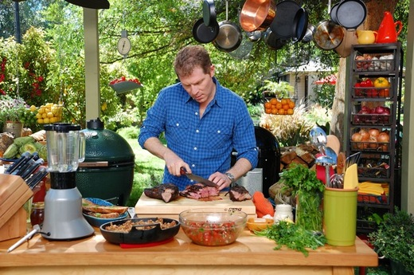
What does the series consist of?
Topics for show segments are practically limitless
Topics are seasonal, hence we could produce a spring season (10 to 13 shows) and a late summer early fall season (same number)
Shows can be broadcast multiple times and be instantly available on demand from the show’s website.

Slide 8
What does a show consist of?
Each show adheres to a strict formula based on minutes dedicated to each segment
Show Open introducing guests
Show’s Opening Animation
Shopping with the Chef
Cooking with the Chef
The Gonzo Gardener
Main Commercial Break
Recipe Wrap-up and Reveal
Show Close and Credits

Slide 9
Key Personnel
There are four key personnel required to mount this production
Executive Producer
Associate Producer/Director
Technical Producer
Host/Segment Producer

Slide 10
Key Personnel
The Executive Producer
Controls finances
Collaborates with staff on direction of the show
Responsible for Operating Budget
Responsible for all sponsor contact and communication
Maintains sponsor contractual agreements
Manages the production of the show’s Annual Report to Sponsors, Stakeholders and Friends of The Co-op Cookery

Slide 11
Key Personnel
Associate Producer/Director
Responsible for day-to-day production of the show
This is a hands-on producer who manages all aspects of production including
Technical support
Graphic design and production
Talent
Production of show segments produced in the field
Post Production
Commercial production

Slide 12
Key Personnel
Technical Producer
Responsible for the line production of the show including
Camera switching
Audio capture and production
Sound mixing

Slide 13
Key Personnel
Host/Segment Producer
On-camera talent
Through collaboration with the Executive Producer and Associate Producer, plans each show’s content including
Guests and co-hosts
Segment topics and production which are accompanied by a separate shooting schedule

Slide 14
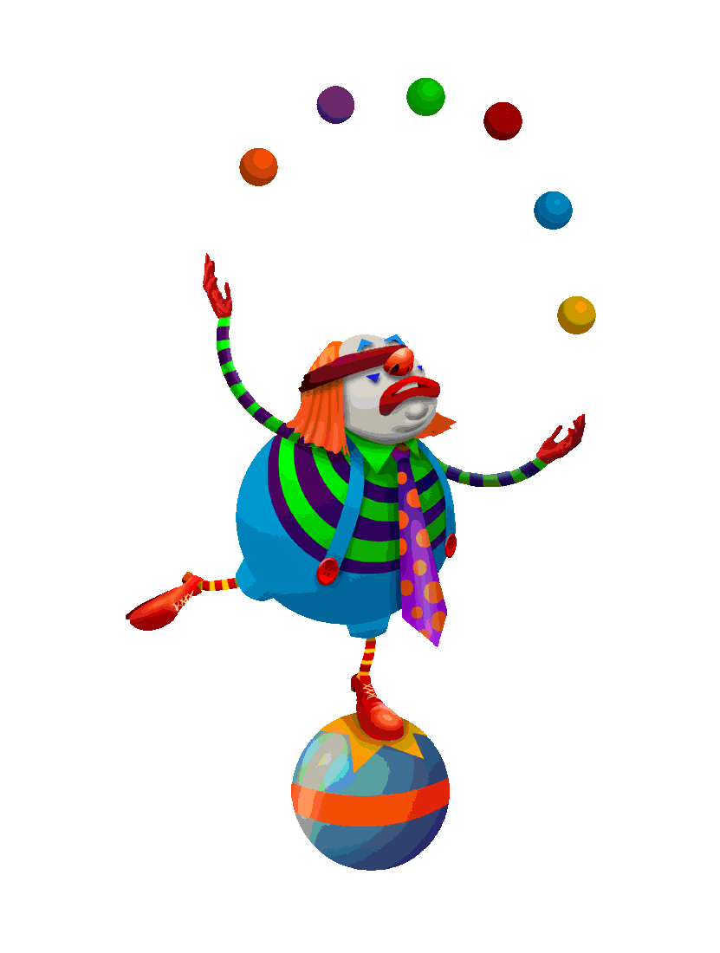
In summary
To create a sustainable production we must treat this project as a business opportunity and thus manage it as a business
The keys to a successful production are talented people with, at the very least, a modicum of media experience

Slide 15
In summary
Among the stakeholders there are excellent opportunities to further one’s individual brand (i.e. we will ALL benefit from the exposure)

Slide 16
Summary
And though our programs will be on YouTube, we don’t want to look like typical YouTube amateur video. We want our programs to look professional in every way.

