Slide 1


Slide 2



Our Show’s Mission
To promote the virtues of locally grown and prepared foods
To promote the virtues of our Dubuque Food Co-op
To promote the virtues of fresh organically grown wholesome foods
To provide opportunities for producers to connect with their customers

Slide 3


Building Brand Equity
Series-style video applied to broadcast, cable and Web television is one of the most powerful and effective means of brand marketing
  Series television affords more exposure, lower cost-per-thousand
  It creates its own audience of enthusiastic fans, and when coupled with social media it builds upon that audience in ways no other marketing form works

Slide 4


Critical to long-term success
Because this is a television project, the show has excellent potential to earn revenue or at the very least earn enough to sustain itself.

Slide 5
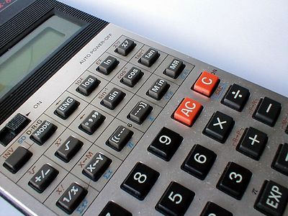
Critical to long-term success
Therefore the show should be organized around a solid business plan with the goal of producing revenue streams from sponsorship contracts.
  Beneficiaries include
    Dubuque Food Co-op
    Matter
    The Co-op Cookery Production

Slide 6
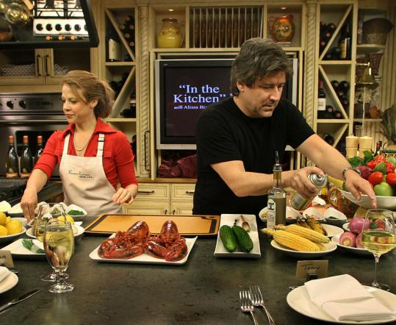
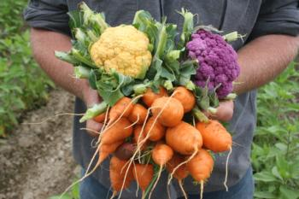
What does a show consist of?
It’s ostensibly a cooking show
  Shopping with the chef
  Cooking on camera
But it’s also a gardening show
  We visit area farms and gardens to learn where food comes from and who grows it

Slide 7
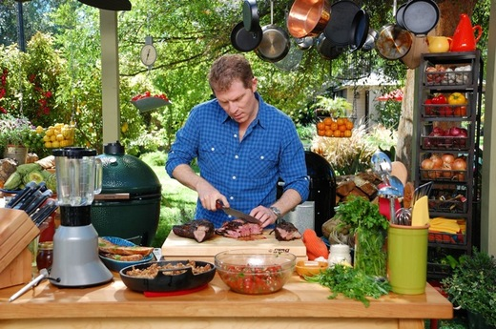

What does the series consist of?
Topics for show segments are practically limitless
Topics are seasonal, hence we could produce a spring season (10 to 13 shows) and a late summer early fall season (same number)
Shows can be broadcast multiple times and be instantly available on demand from the show’s website.

Slide 8

What does a show consist of?
Each show adheres to a strict formula based on minutes dedicated to each segment
  Show Open introducing guests
  Show’s Opening Animation
  Shopping with the Chef
  Cooking with the Chef
  The Gonzo Gardener
  Main Commercial Break
  Recipe Wrap-up and Reveal
  Show Close and Credits

Slide 9

Key Personnel
There are four key personnel required to mount this production
  Executive Producer
  Associate Producer/Director
  Technical Producer
  Host/Segment Producer

Slide 10
Key Personnel
The Executive Producer
  Controls finances
  Collaborates with staff on direction of the show
  Responsible for Operating Budget
  Responsible for all sponsor contact and communication
    Maintains sponsor contractual agreements
    Manages the production of the show’s Annual Report to Sponsors, Stakeholders and Friends of The Co-op Cookery

Slide 11
Key Personnel
Associate Producer/Director
  Responsible for day-to-day production of the show
  This is a hands-on producer who manages all aspects of production including
    Technical support
    Graphic design and production
    Talent
    Production of show segments produced in the field
    Post Production
    Commercial production

Slide 12
Key Personnel
Technical Producer
  Responsible for the line production of the show including
    Camera switching
    Audio capture and production
    Sound mixing

Slide 13
Key Personnel
Host/Segment Producer
  On-camera talent
  Through collaboration with the Executive Producer and Associate Producer, plans each show’s content including
    Guests and co-hosts
    Segment topics and production which are accompanied by a separate shooting schedule

Slide 14
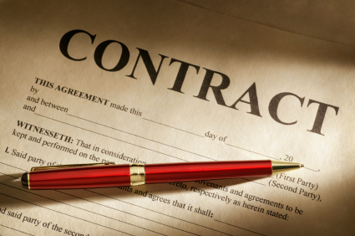
Ongoing Production Costs
All costs associated with production will be paid for from revenue produced through the sale of sponsor/advertising contracts
Sponsor contracts will be sold as 13 or 26 show schedules

Slide 15
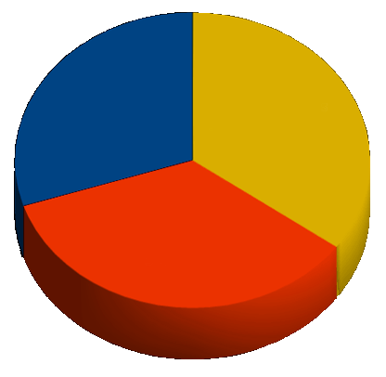
Revenues will be split
Revenue from contract sales will be split between the Dubuque Food Co-op, Matter and the show’s production entity in amounts yet to be determined
  Our largest production cost will be key personnel compensation

Slide 16
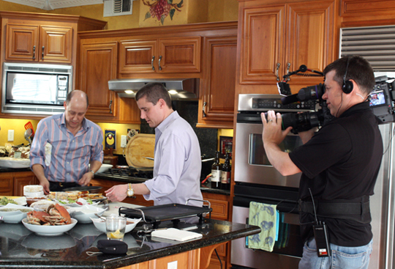
Distribution of revenue
A percentage of revenue must be budgeted for production costs such as
  Equipment repair and replacement
  Kitchen Supplies
  Consumables including lighting, batteries, cables, wearables (embroidered logo aprons), signage, cleaning supplies, etc.

Slide 17
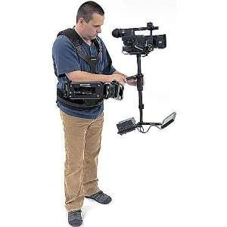
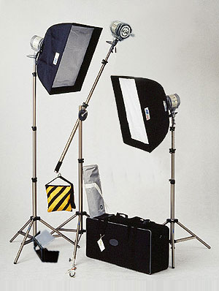
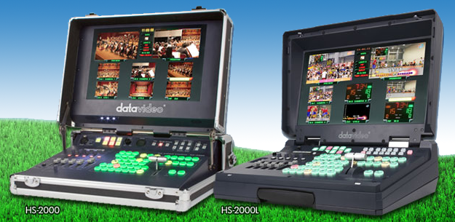
Where we can find additional support
The Dubuque Cable Commission
  We are a not-for-profit and eligible for equipment support from the Cable Commission’s Franchise Agreement
  And we need a Steadicam brace, a camera switcher and some lighting units

Slide 18
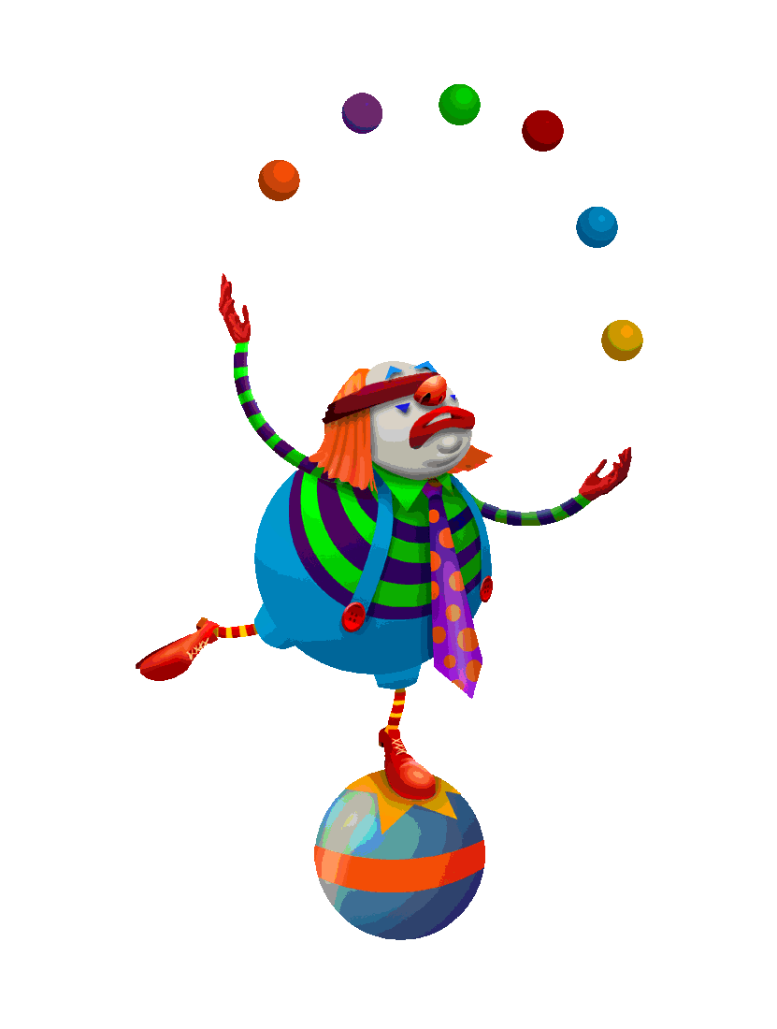
In summary
To create a sustainable production we must treat this project as a business opportunity and thus manage it as a business
The keys to a successful production are talented people with, at the very least, a modicum of media experience

Slide 19
In summary
Among the stakeholders there are excellent opportunities to further one’s individual brand
(i.e. we will ALL benefit from the exposure)

Slide 20

Summary
And though our programs will be on YouTube, we don’t want to look like typical YouTube amateur video. We want our programs to look professional in every way.

Slide 21








And something to think about
Negotiate with KWWL or KCRG, local network affiliates that have digital over-the-air channels which could carry our show. Our show would not only appear on Mediacom Cable, but DirecTV, Dish Network and terrestrial broadcast, a win-win for Mediacom, our sponsors and stakeholders.

